Slide 1
PC Based Data Acquisition
K. Poddar
Aerospace Engineering
IIT Kanpur

Slide 2
Presentation Overview
Virtual instrumentation
Data acquisition system components
Data acquisition fundamentals
LabVIEW based data acquisition
Examples

Slide 3
Overview of Virtual Instruments and Measurements
Virtual instrumentation combines hardware and software with industry-standard
computer technologies to create user-defined instrumentation solutions. We
can have plug-in and distributed hardware and driver software for DAQ, IEEE
488 (GPIB), PXI, serial, and industrial communications.
The driver software is the application programming interface (API) to the hardware.
Application software can be LabVIEW, LabWindows/CVI , and any other software.
Taking Measurements with Virtual Instruments
Different hardware and software components can make up a virtual instrumentation
system. We can use a variety of hardware components to monitor or control a
process or to test a device. We can connect the hardware to the computer and
understand how the hardware takes measurements, and incorporate hardware
into a virtual instrumentation system.

Slide 4
First Definitions
Measurement:
  The quantitative determination of a physical characteristic. In practice, measurement is the conversion of a physical quantity or observation to a domain where a human being or computer can determine the value.
Instrumentation:
  Devices for converting a physical quantity to a quantity observable by a human or machine (computer). For example, a mercury thermometer converts temperature to a column length that can be seen by the human eye.
Data Acquisition
  Gathering information from measurement sources, such as sensors and transducers.
Sensor
  Device that responds to a physical stimulus (heat, light, sound, pressure, motion, flow, and so on), and produces a corresponding electrical signal.

Slide 5
Transducers, Sensors and Actuators
The terms sensors and transducer are used interchangeably in modern usage
But technically, “a transducer is a device that converts a signal from one physical form to a corresponding signal that has a different physical form. Therefore it is an energy converter”.
The term actuator is preferred when an electrical signal is converted to mechanical action
Actuators are often classified by the power source they use such as hydraulic or pneumatic as well as electrical
  Control signals that cause actuation; can be mechanical as well as electrical

Slide 6
Data Acquisition: System Components
Today, most scientists and engineers use personal computers (PCs)
with PCI, PXI/CompactPCI, PCMCIA, USB, IEEE 1394, ISA, or parallel
or serial ports for data acquisition in laboratory research, test and
measurement, and industrial automation. Many applications use plug-in
devices to acquire data and transfer it directly to computer memory.
Obtaining proper results from a PC-based DAQ system depends on each
of the following system elements:
• Transducers
• Signal Conditioning
• DAQ Hardware
• Software
• The PC

Slide 7
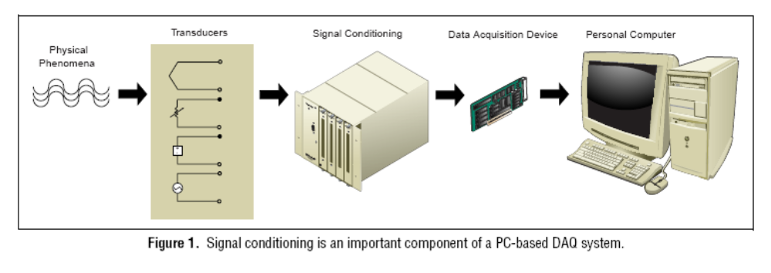
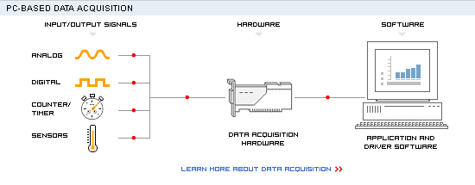
End to End Data Acquisition (DAQ)
Graphics from www.ni.com DAQ Fundamentals

Slide 8
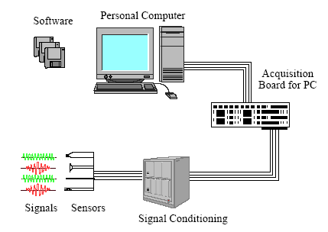
DAQ System Components

Slide 9
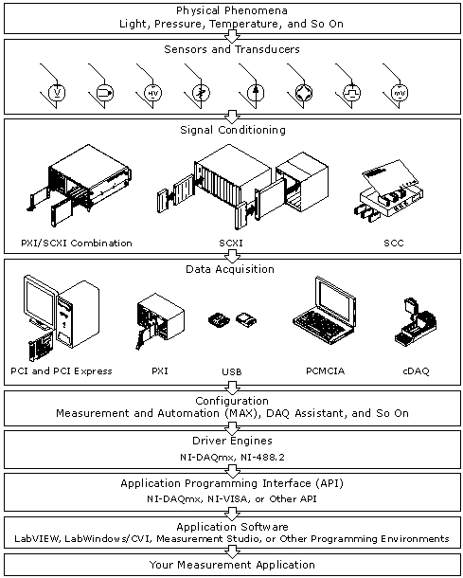
DAQ System
Components

Slide 10
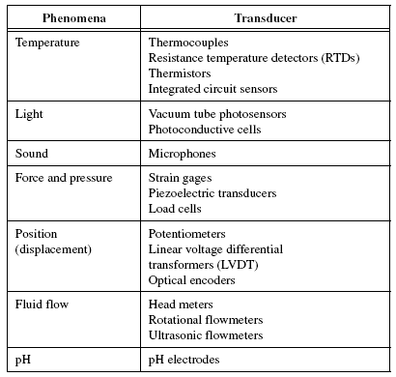
Transducers

Slide 11
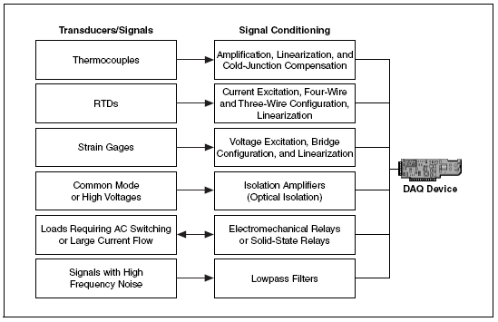
Signal Conditioning

Slide 12
DAQ Hardware: A/D Board
• The simplest way to measure a signal is with a voltmeter; however
some experiments require the use of computers to synchronize
data acquisition and record large quantities of data.
• An Analog-to-Digital (A/D) board plugs into an expansion slot of a
personal computer and is the means for digitizing and storing the
analog voltage signals from various sensors. The digital data is
then saved on the computer’s hard disk.
• An A/D board does not record continuous records (like a strip chart
or seismograph), but rather it records instantaneous values of the
signals through different channels at a discrete sampling frequency.
• This allows post-processing of the digitized signal by manipulating
a series of data points after they are acquired.

Slide 13
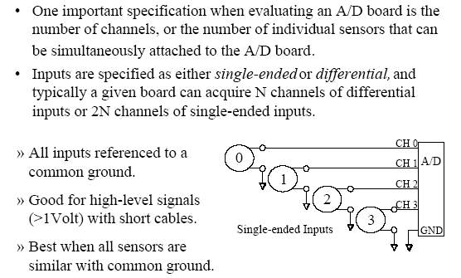
Data Acquisition: Single-ended Analog Input

Slide 14
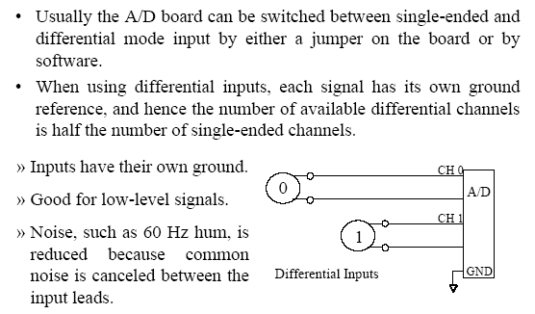
Data Acquisition: Differential Analog Input

Slide 15
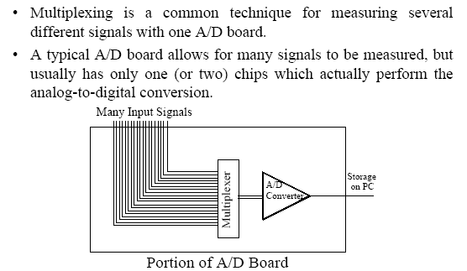
Data Acquisition: A/D Multiplexing

Slide 16
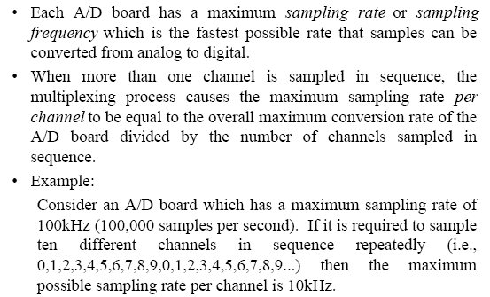
DAQ: Sampling Rate & Multiplexing

Slide 17
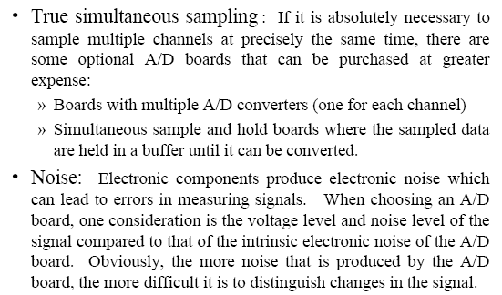
DAQ: Other Considerations

Slide 18
DAQ Software
Software transforms the PC and the DAQ hardware into a complete data acquisition, analysis, and display system.
DAQ hardware without software is useless – and DAQ hardware with poor software is almost useless.
The majority of DAQ applications use driver software. Driver software is the layer of software that directly programs the registers of the DAQ hardware, managing its operation and its integration with the computer resources, such as processor interrupts, DMA, and memory. Driver software hides the low-level, complicated details of hardware programming, providing the user with an easy-to-understand interface.

Slide 19
DAQ Fundamentals

Slide 20
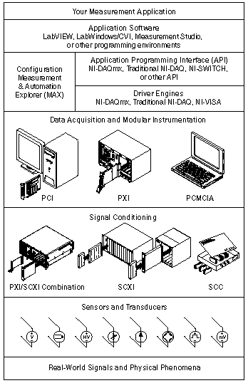
Measurement System
This figure depicts the measurement
system overview, showing the path
of real-world physical phenomena
to your measurement application.
Notes:
Sensors and transducers detect physical phenomena. Signal conditioning components condition physical phenomena so that the measurement device can receive the data. The computer receives the data through the measurement device. Software controls the measurement system, telling the measurement device when and from which channels to acquire or generate data. Software also takes the raw data, analyzes it, and presents it in a form you can understand, such as a graph, chart, or file for a report.
NI measurement devices and application software are packaged with NI-DAQ driver software to program all the features of your NI measurement device such as configuring, acquiring, and generating data from and sending data to NI measurement devices. Using NI-DAQ saves you from having to write these programs yourself. Application software, such as LabVIEW, LabWindows/CVI, and Measurement Studio, sends the commands to the driver, such as acquire and return a thermocouple reading, and then displays and analyzes the data acquired.
You can use the NI-DAQ driver from NI application software or from any programming environment that supports calling dynamic link libraries (DLLs) through ANSI C interfaces. Regardless of the programming environment, your DAQ application uses NI-DAQ, as shown in the figure.

Slide 21
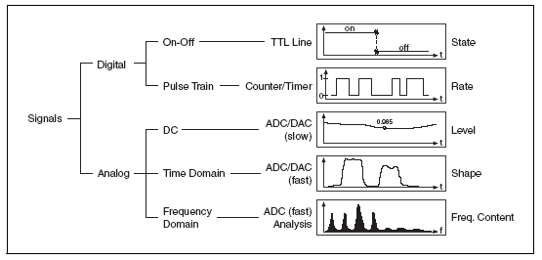
Signal Types
A signal is classified as analog or digital by the way it conveys information.
A digital signal has only two possible discrete levels-high level or low level.
An analog signal, on the other hand, contains information in the continuous
variation of the signal with respect to time. A breakdown of the main signal
types is shown below.

Slide 22
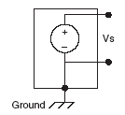
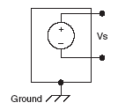
Analog Signals
To measure analog signals properly, we must know
  Signal source: Grounded or Floating
  Measurement system to use: Differential, RSE, or NRSE
Signal Sources
Grounded Signal Sources
Floating Signal Sources
Notes:
Grounded Signal Sources
A grounded source is one in which the voltage signals are referenced to a system ground, such as earth or building ground, as shown in the following figure.
Because such sources use the system ground, they share a common ground with the measurement device. The most common examples of grounded sources are devices that plug into the building ground through wall outlets, such as signal generators and power supplies.
Measuring Grounded Signal Sources
A grounded signal source is best measured with a differential or an NRSE measurement system. If you use an RSE measurement system with a grounded source, the result is typically a noisy measurement system often showing power-line frequency (60 Hz) components in the readings. Ground-loop introduced noise can have both AC and DC components, introducing offset errors and noise in the measurements. The potential difference between the two grounds causes a current to flow in the interconnection. This current is called ground-loop current.
However, you can still use an RSE measurement system if the signal voltage levels are high and the interconnection wiring between the source and the measurement device has a low impedance. In this case, the signal voltage measurement is degraded by ground loop, but the degradation may be tolerable. You must observe the polarity of a grounded signal source before connecting the signal to a ground-referenced measurement system because the signal source can be short-circuited to ground, which can damage the signal source.
Floating Signal Sources
In a floating source, the voltage signal is not connected to any absolute reference or any common ground, such as earth or building ground as shown in the following figure.
Floating signal sources are also called nonreferenced signal sources. Some common examples of floating signal sources are batteries, thermocouples, transformers, and isolation amplifiers. Notice in the figure that neither terminal of the source is connected to the electrical outlet ground, so each terminal is independent of the system ground.
Measuring Floating Signal Sources
You can measure floating signal sources with both differential and single-ended measurement systems. In the case of the differential measurement system, however, make sure the common-mode voltage level of the signal with respect to the measurement system ground remains in the common-mode input range of the measurement device. A variety of phenomena—for example, the instrumentation amplifier input bias currents—can move the voltage level of the floating source out of the valid range of the input stage of a DAQ device.

Slide 23
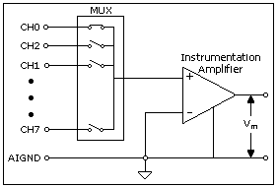
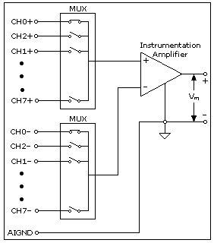
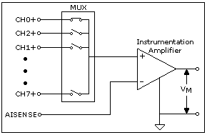
Measurement System Types
RSE
Differential
NRSE
Notes:
Differential Measurement System
A differential measurement system has neither of its inputs tied to a fixed reference, such as earth or building ground. A differential measurement system is similar to a floating signal source in that the measurement is made with respect to a floating ground that is different from the measurement system ground. Hand-held, battery-powered instruments and DAQ devices with instrumentation amplifiers are examples of differential measurement systems.
The following figure shows an implementation of an 8-channel differential measurement system used in a typical NI device. Analog multiplexers are used in the signal path to increase the number of measurement channels when there is only a single instrumentation amplifier. For this device, the pin labeled AIGND, the analog input ground, is the measurement system ground.

Slide 24
Measuring Floating & Grounded Signals
Measuring Floating Signal Sources
  You can measure floating signal sources with both differential and
  single-ended measurement systems.
Measuring Grounded Signal Sources
  A grounded signal source is best measured with a differential or an
  NRSE measurement system. If you use an RSE measurement system
  with a grounded source, the result is typically a noisy measurement
  system often showing power-line frequency (60 Hz) components in
  the readings. Ground-loop induced noise can have both AC and DC
  components, introducing offset errors and noise in the measurements.

Slide 25
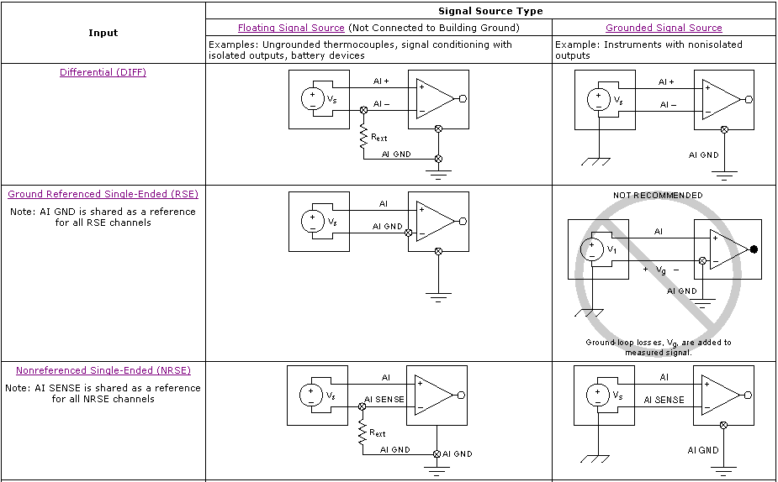
Measurement System Types and Signal Sources

Slide 26
Signal Conditioning
The manipulation of signals to prepare them for digitizing is called
signal conditioning. Common types of signal conditioning include
the following:
  Amplification
  Filtering
  Linearization
  Transducer Excitation
  Isolation

Slide 27
Sampling Considerations
Device range
Limit settings
Resolution
Code width
Sampling rate

Slide 28
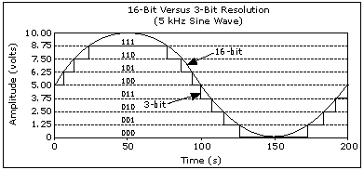
Resolution
Resolution is the smallest amount of input signal change that a device or sensor can detect. The number of bits that an ADC uses to represent the analog signal is the resolution. The higher the resolution, the larger the number of divisions the range is broken into, and therefore, the smaller the detectable voltage change.

Slide 29
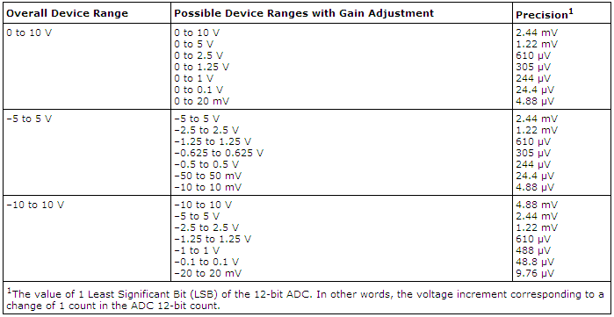
Code Width
The range, resolution, and gain available on a DAQ device determine the smallest detectable change in voltage. This change in voltage represents 1 least significant bit (LSB) of the digital value and is often called the code width.

Slide 30
Sampling Rate
One of the most important parameters of an analog input or output system
is the rate at which the measurement device samples an incoming signal or
generates the output signal. The sampling rate determines how often an
analog-to-digital (A/D) or digital-to-analog (D/A) conversion takes place.
A fast input sampling rate acquires more points in a given time and can form
a better representation of the original signal than a slow sampling rate.
Sampling too slowly results in a poor representation of the analog signal.
Under-sampling causes the signal to appear as if it has a different frequency
than it actually does. This misrepresentation of a signal is called aliasing.

Slide 31
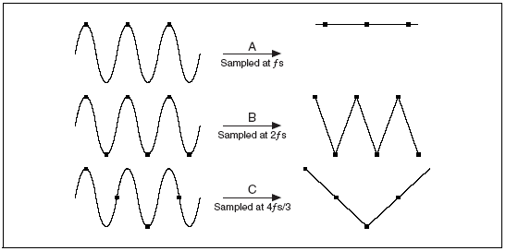
Determining How Fast to Sample
For frequency measurements, according to the Nyquist theorem, you must sample at a rate greater than twice the maximum frequency component in the signal you are acquiring to accurately represent the signal.

Slide 32
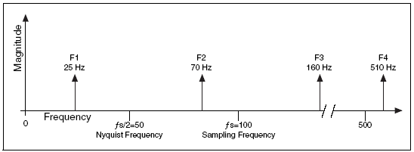
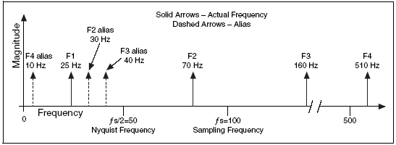
Aliasing
Alias Freq. = ABS (Closest Int. Mult. of Sampling Freq. - Input Freq. )

Slide 33
Triggering
A trigger is a signal that causes an action, such as
starting the acquisition of data.
  Analog trigger
  Digital trigger

Slide 35
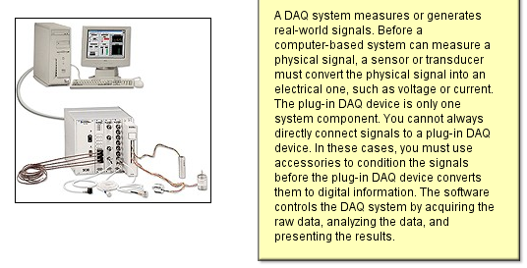
DAQ System Components

Slide 36
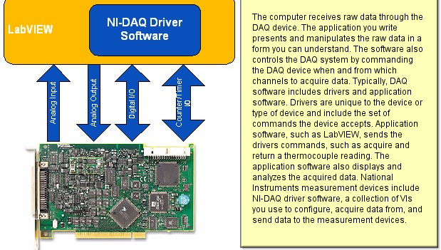
DAQ System Components

Slide 37
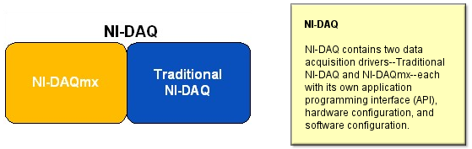

Slide 38
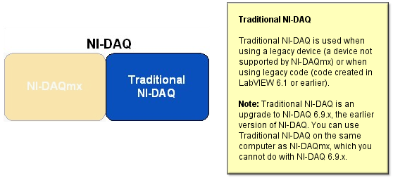

Slide 39
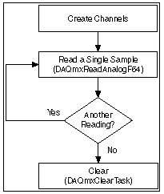
Programming Flowcharts
Analog Input Programming Flowcharts
  Single Sample Analog Input
  Finite Analog Input
  Continuous Analog Input
  Triggered Acquisition
Single Sample Flowchart

Slide 40
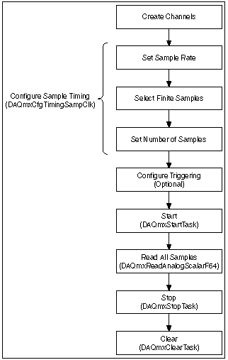
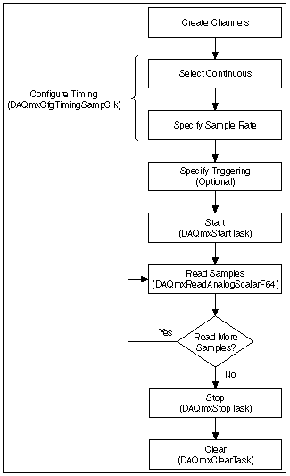
Finite Sample Flowchart
Continuous Sample Flowchart

Slide 41
Analog Output Programming Flowcharts
  Single Sample Analog Output
  Finite Analog Output
  Continuous Analog Output

